Slide 1


READING & WRITING
Learning to blend literacy skills to produce fact and fiction texts fit to showcase to an audience.

Slide 2

CUSP Reading & Writing is an evidence informed, carefully sequenced English curriculum, which maps core content in Reading and Writing across the primary journey, ensuring that learning is taught and revisited over time so that pupils commit their understanding to the long-term memory.
Writing
CUSP Writing draws on taught content from CUSP History, Geography and Science and from the in-depth study of core texts from the literature spine. Expert subject knowledge is carefully woven into each writing module which gives teachers the opportunity to teach and rehearse key knowledge and skills before applying this learning to meaningful extended outcomes.
The careful architecture of this curriculum ensures that pupils build on prior learning and maximise purposeful curriculum connections to become writers for life.
Punctuation and grammar is taught directly within the CUSP curriculum and pupils receive separate spelling CUSP lessons.
Reading
CUSP Reading is deliberately designed to be ambitious and aspirational, ensuring that every child leaves our school as a competent, confident reader. Drawing on the latest research around explicit vocabulary instruction, reading fluency and key comprehension strategies, this curriculum is a synthesis of what we know works in helping children make outstanding progress in reading and a distillation into consistent, well-structured practice.
Pupils will receive a daily diet of excellent reading teaching and this will be supplemented by regular opportunities to engage with shared reading experiences, promoting the joy of reading with the whole school community. The clear structure and principles ensure that teaching is progressive, challenging and engaging and the rich, diverse literature spine acts as both a mirror so that every child can see themselves in the core texts and as a mirror to engage pupils with experiences beyond their own field of reference.

Slide 3
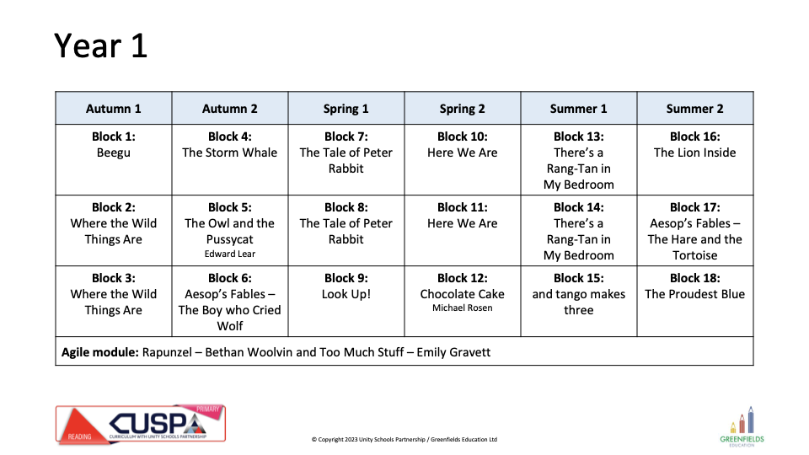
CUSP Literature Spine
Each cohort will have a suite of core texts that will form the depth study for the academic year. These texts represent a promise from the school to every pupil that it serves of the literature that it is committed to studying throughout a pupil’s school journey. These texts have been mapped carefully to ensure a breadth of experiences, authors, texts and themes is addressed across the Primary years. In addition to these texts, there are core poems that each year group will study in detail. Other texts that will be studied in part will be outlined within the curriculum. This spine represents the core texts for depth study only. The literature spine has been harmonised with the wider curriculum, where appropriate.
KS1 Cycle A

Slide 4
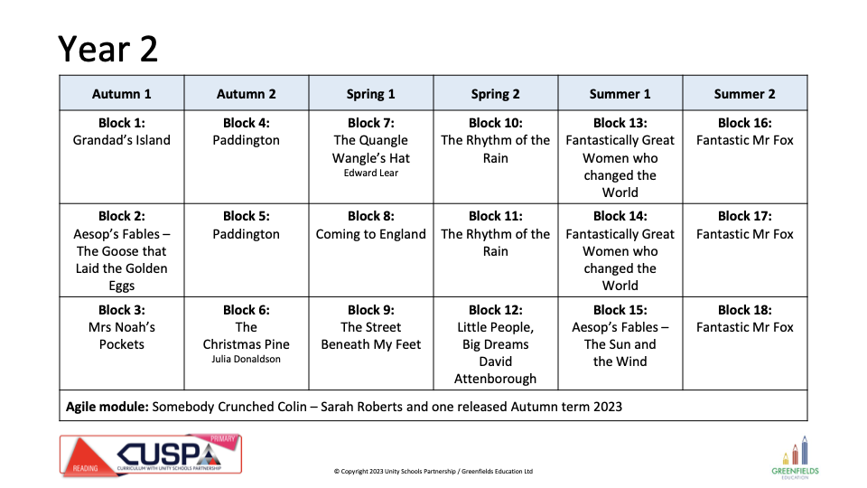
KS1 Cycle B

Slide 5
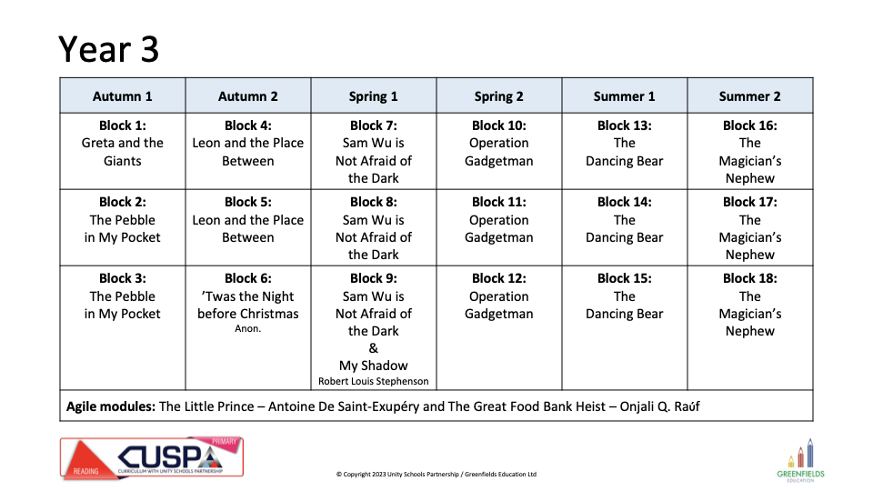
LKS2 Cycle A

Slide 6
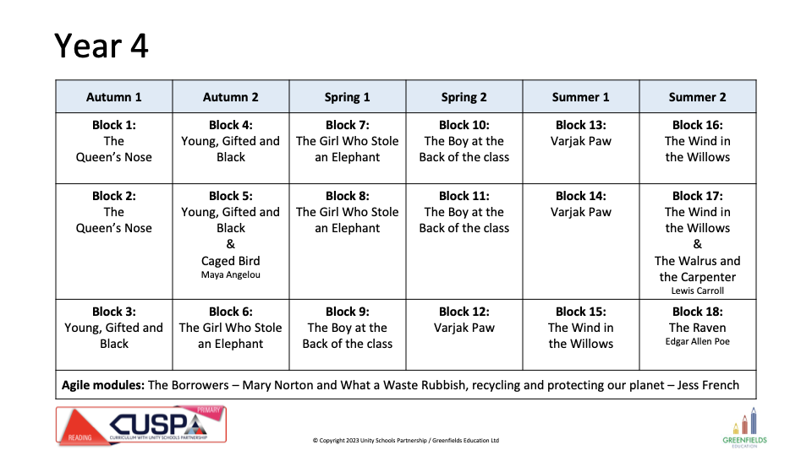
LKS2 Cycle B

Slide 7
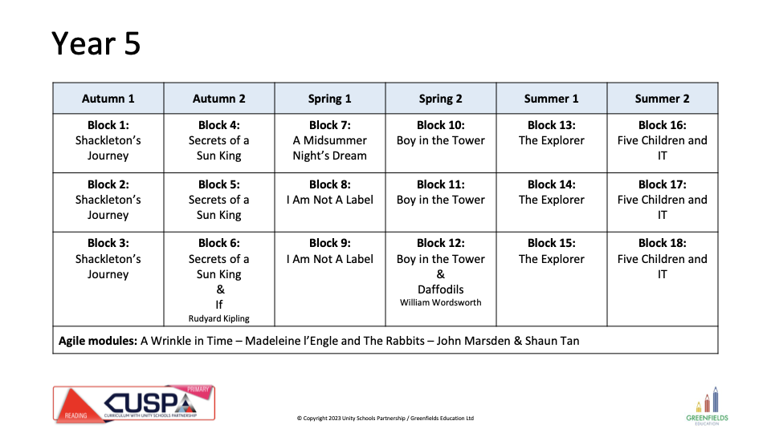
UKS2 Cycle A

Slide 8
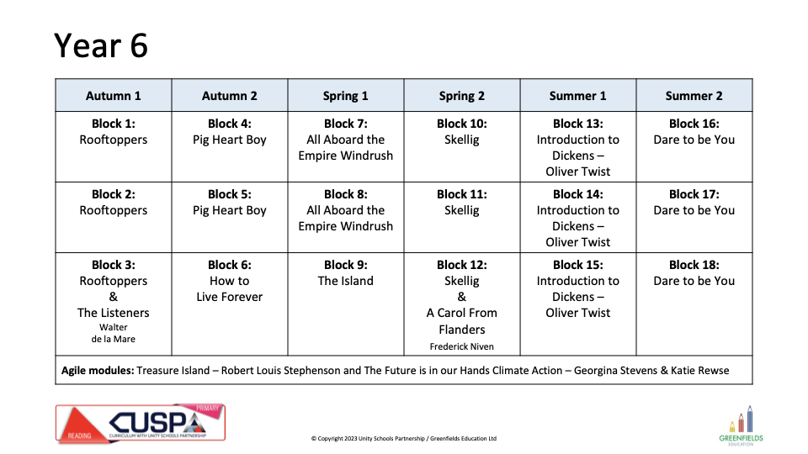
UKS2 Cycle B

