Slide 1


ART & DESIGN
Learning to create expressive work,
drawing on the techniques of inspiring artists and designers.

Slide 2
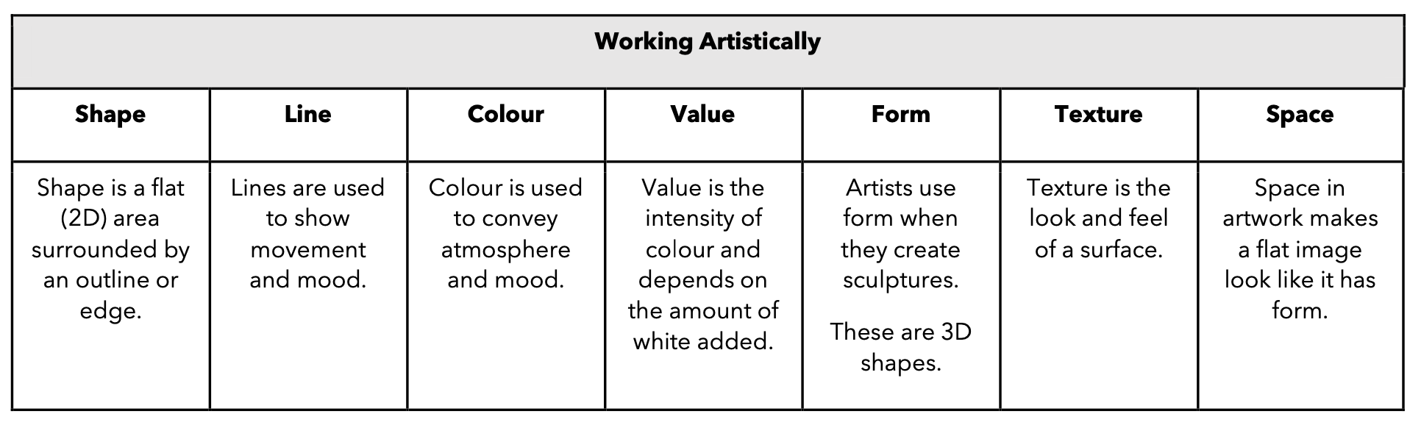

CUSP Art and Design has been deliberately built around the principles of evidence-led practice. This is to ensure that pupils are equipped to successfully think, work and communicate like an artist. Unapologetically ambitious, our art curriculum focuses on excellence in this subject through a myriad of media and incredible artists.
Our intention is unmissable; exceptional teacher instruction inspires pupils to acquire knowledge, as an artist, and enable them to skilfully attempt and apply their understanding.
The CUSP Art curriculum is organised into blocks with each block covering a particular set of artistic disciplines, including drawing, painting, printmaking, textiles, 3D and collage. Vertical progression in each discipline has been deliberately woven into the fabric of the curriculum so that pupils can revisit key disciplines throughout their Primary journey at increasing degrees of challenge and complexity.
In addition to the core knowledge required to be successful within each discipline, the curriculum outlines key aspects of artistic development in the Working Artistically section. Each module will focus on developing different aspects of these competencies. This will support teachers in understanding pupils’ development as artists more broadly, as well as how successfully they are acquiring the taught knowledge and skills.

