Slide 1
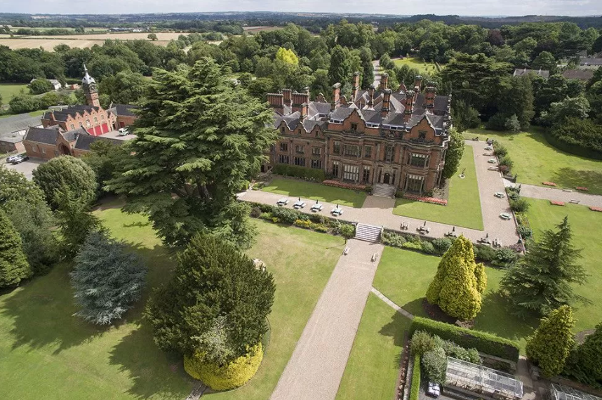
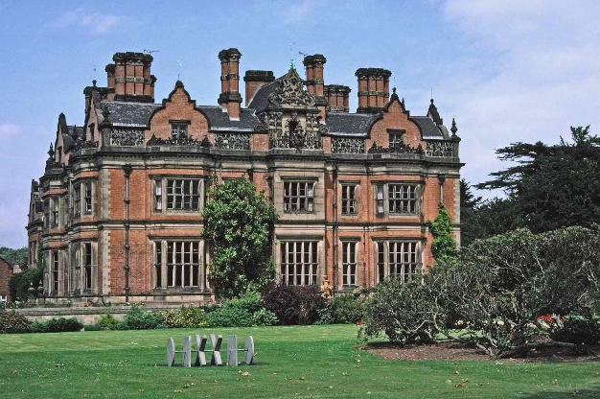
Beaumanor Hall
September 2023

Slide 2
Every Child Matters to Us!
Building Friendships
Developing independence
Confidence in the self
Working collaboratively
New experiences
Broadening horizons

Slide 3
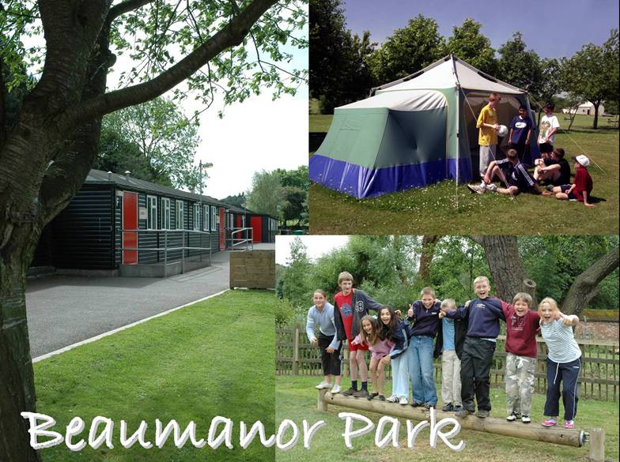

Slide 4


Slide 5
Pick up- Wednesday 27th September
Transport is provided by Ausden Clark and collects each school in turn.
Ullesthorpe 8:45am (arrive at school by 8.30am)
Sharnford 9:05am (arrive at school for 8.45am)
All Saints 9:15am (arrive at school for 8.45am)
We arrive about 10:15am
Travel sickness tablets to be given before dropping off your child. If they require some for the homeward journey, please give that to the accompanying adult in a labelled bag or envelope.

Slide 6
Essential Items
Children will have to transfer their own luggage- a wheeled suitcase is best.
Sleeping bag and pillow with their pillowcase fitted in a labelled black bag with a spare for the way back.
Waterproof (rather than showerproof) Kagool or Anorak
Hat and gloves
Trainers ( to wear on the coach)
Wellingtons
Slippers/indoor footwear
Trousers + Long sleeve T-shirt + Sweatshirt x 3 (to help your child with their clothes, please place 1 set packed in a separate labelled bag with underwear for each day)
4 sets of underwear including vests or t-shirts
4 pairs of socks
Towel
Pyjamas or Nightdress
Dressing gown
Additional Items
Small Cuddly Toy
Hairbrush, comb, soap in a box, shower gel, facecloth, toothbrush and paste (all in toilet bag)
Reading book / small game (quiet game i.e. chess or dominoes etc.)
Notes:
From experience - wheeled case definitely best.
Spare black bag - because they will always get excited about setting out their bedding and rip the bag in their rush so need another one for the journey back
Please pack the case with your child so they know what is in it - have had children say no they don’t have another top/jumper etc and when we help them look it is in their case - they just didn’t know it was there.
Wellies - useful for them to be easy accessible as if it is wet on the day we go they will want to change into them when we get there - we usually do an orientation session in the morning after we arrive. A bag for them is useful especially if they are in their case.
Old clothes are preferred as they may get wet/dirty.

Slide 7
Additional Items
Expensive items are likely to get lost or damaged and we advise that they are left at home.
Children are welcome to bring a small game to play with their friends although we will have a variety of equipment with us to share.
Please no: Mobile phones or electronic devices
Money
Sweets or additional food.
Medicines: Must be labelled with your child’s name and given to school staff on departure. We can only administer them if the pink form has been returned.
Please label all items you send, including these personal games and toys.
Notes:
Expensive items - no phones, electronic games, fitbits
No additional food - Beaumanor provides plenty of food - children never hungry. When look at the daily activity - after evening activity we have hot chocolate and biscuits in cabin.
Please make sure that you do label everything, especially medicines and give everything to us before we leave on the Wednesday

Slide 8
On Arrival
Children are accompanied to the cabins. These are centrally heated, comfortable and secure.
Children sleep in same sex rooms with adults in adjoining rooms so they can be supervised.
If your child has any sleep challenges, this should have been included on the medical response forms. If you have any concerns, please talk to your child’s teacher.
Notes:
Cabins - Al lsaints in one double cabin, sharnford and Ullesthorpe share the other. Pairs of cabins are linked
Sleep challenges - if you ahven’t put it on the form please do talk to your child’s teacher

Slide 9
Typical day
7:30 Breakfast in the Main Hall (hot and cold)
9:30 - 12:00 Activity 1
12:00 - 1:30 Lunch (packed lunch)
1:30 - 4:00 Activity 2
4:00 - 5:30 Social Time
5:30 - 8:00 Evening Meal followed by Evening Activities
Notes:
Social time - we take a selection of activities including some balls, games. Children encouraged to bring quite activities for use in the cabins - book, drawing things, colouring, small games. No electronic games or expensive items - including fitbits, phones.

Slide 10
Daytime Activities
Canoeing- 2 kayaks tied together so very stable- requires teamwork!
Survival- bushcraft, building shelters, lighting fires
Archery- skill and tests their perseverance!
Climbing- stepping outside of their comfort zones
Evening Activities
Cellar Games - hide and seek
Gym games - we have access to a hall where the children will play team games

Slide 11
Mealtimes
Beaumanor Hall is well known for providing delicious, child friendly and nutritious meals.
Always a range of choices (including vegetarian and other dietary requirements) and something for everyone. Portions are generous.
There is a choice of toast and cereals, fruit and juice for breakfast.
There is a choice of hot food and a cold salad table for the evening meal.
At lunchtime, children have a packed lunch with a sandwich of their choice (they have already made this choice at school)
If you have any concerns, please speak to your child’s teacher
Notes:
Breakfast - also includes hot/cooked breakfast choices
Lunch - sandwich, drink, fresh fruit and either - biscuit, muffin, crisps
Should have filled in forms with any dietary requirements - BH very good at catering for different needs

Slide 12
Keeping in Touch
School staff will stay in touch with their respective schools and let them know when we have arrived and how the trip is progressing.
We will administer First Aid if it is required and contact you immediately should there be any problems with your child’s health or behaviour.
If you need to contact us during school hours, contact your school office.
Out of hours, call 07782 545909
Notes:
We have a very experienced first aider plus several of the staff are also first aid trained.

Slide 13
Returning Home- Friday 29th September
All Saints - 2:50pm
Sharnford - 3:00pm
Ullesthorpe - 3:15 pm
All times are approximate
You are welcome to collect your child when the coach arrives back at school or at the end of the school day.
We will stay in touch with office staff, inform them when we leave and let you know if there are any significant delays or hold ups.

