Slide 1
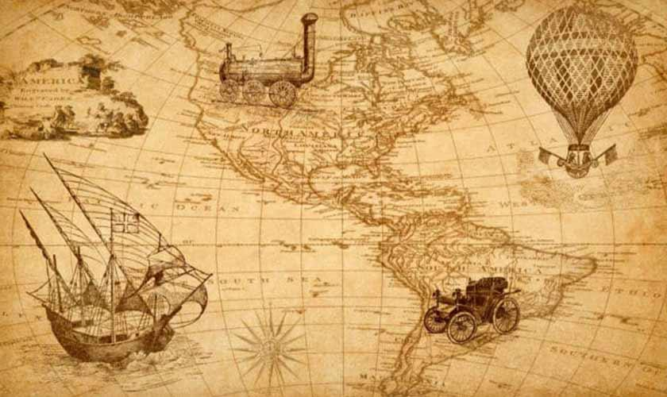

HISTORY
The study of the past - learning about people, places, events and changes.

Slide 2
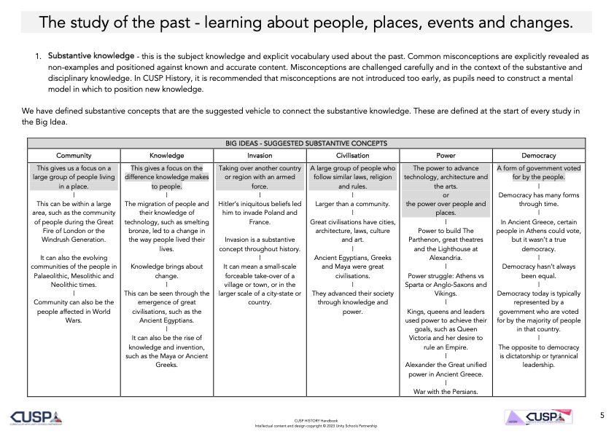

Slide 3
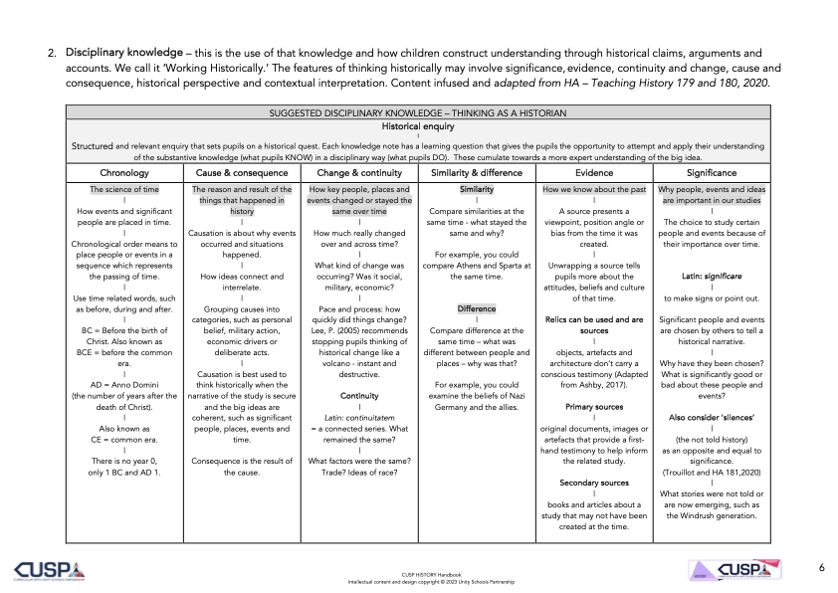

Slide 4
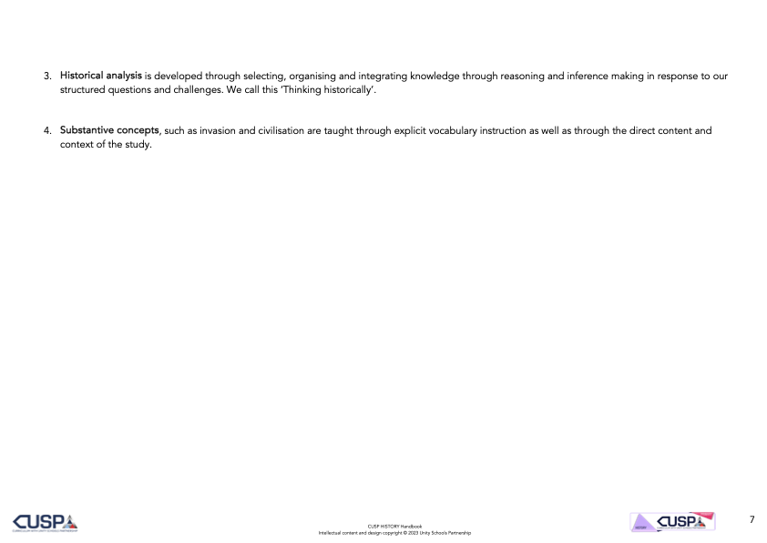

Slide 5


