Slide 1


SCIENCE
Learning to explore our universe and
everything flourishing within it.

Slide 2
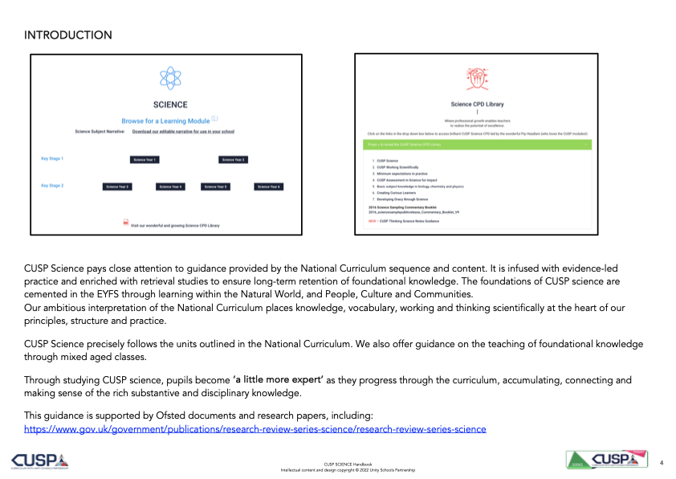

Slide 3
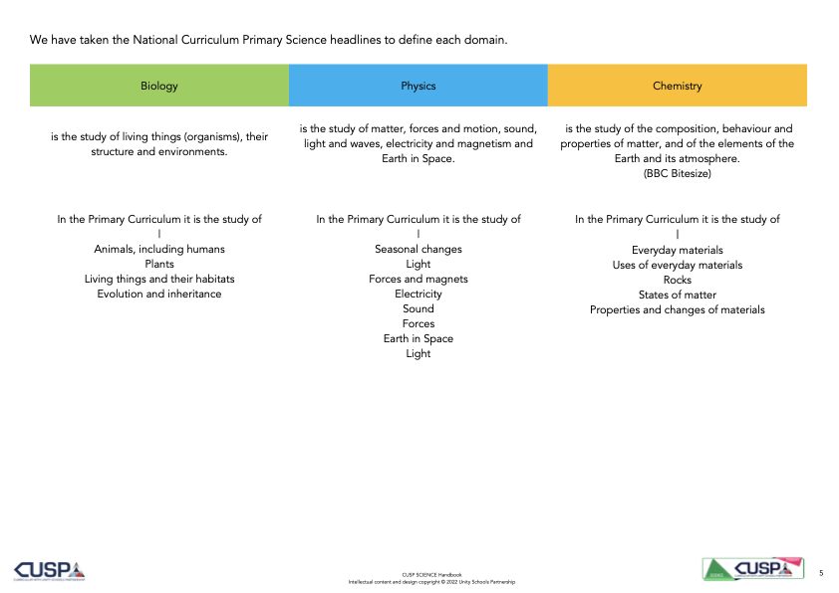

Slide 4
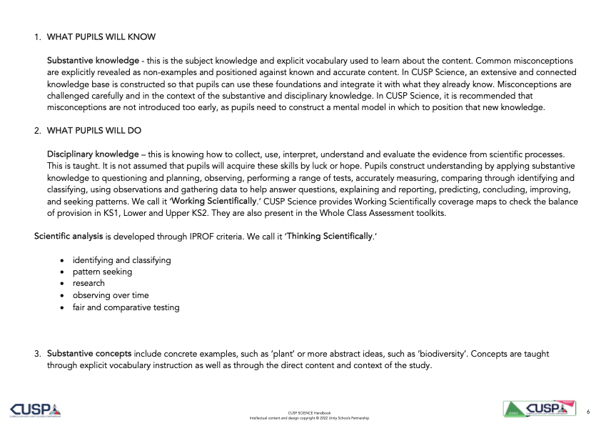

Slide 5


